Slide 1
FINANCIAL STATEMENTS ANALYSIS
Meaning, Users, Ratio Analysis, Types of ratios

Slide 2
What is Financial Analysis?
Financial Analysis is the process of identifying the financial strengths and weaknesses of the firm by properly establishing relationships between the items of the Balance Sheet and the Profit and Loss Account

Slide 3
Who are interested in Financial Analysis?
Financial analysis can be undertaken by management of the firm, or by parties outside the firm.
The nature of analysis will differ depending on the purpose of the analyst.
Users of Financial Analysis:
1. Trade Creditors 2. Suppliers of long-term debt
3. Investors 4. Management

Slide 4
Nature of Ratio Analysis
Ratio Analysis is a powerful tool of financial analysis
A ratio is defined as “the indicated quotient of two mathematical expressions” and as “the relationship between two are more things.”
In financial analysis, a ratio is used as a benchmark for evaluating the financial position and performance of a firm.
The relationship between two accounting figures, expressed mathematically, is known as a financial ratio.

Slide 5
Standards of Comparison
The ratio analysis involves comparison for a useful interpretation of the financial statements. A single ratio does not indicate favorable or unfavorable condition. It should be compared with some standard.

Slide 6
Standards of comparison may consist of:
Past ratios: ratios calculated from the past financial statements of the same firm;
Competitors’ ratios: ratios of some selected firms, especially the most progressive and successful competitor, at the same point of time;
Industry ratios: ratios of the industry to which the firm belongs; and
Projected ratios: i.e., ratios developed using the projected, or proforma financial statements of the same firm.

Slide 7
Types of Ratios
Several ratios, calculated from the accounting data, can be grouped into various classes according to financial activity or function to be evaluated.
Shot-term creditors main interest is in the liquidity position or the short-term solvency of the firm.
Long-term creditors, on the other hand, are more interested in the long-term solvency and profitability of the firm.
Similarly, owners concentrate on the firm’s profitability and financial condition.
Management is interested in evaluating every aspect of the firm’s performance. They have to protect the interests of all parties and see that firm grows profitably.

Slide 8
Four Categories of Ratios:
In view of the requirements of the various users of ratios, we can classify ratios into the following four important categories:
1.Liquidity Ratios: measure the firm’s ability to meet current obligations;
2.Leverage Ratios: show the proportions of debt and equity in financing the firm’s assets,
3.Activity Ratios: reflect the firm’s efficiency in utilizing its assets,
4.Profitablity Ratios: measure overall performance and effectiveness of the firm.

Slide 9
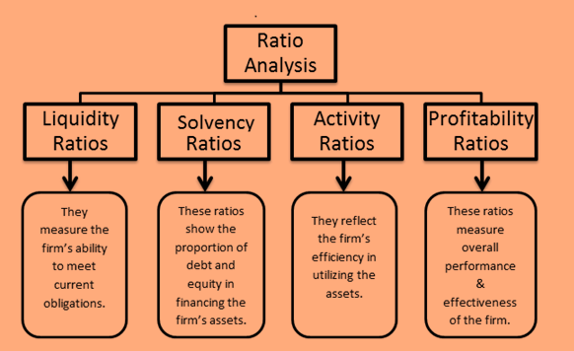

Slide 10
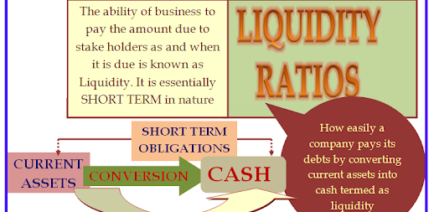

Slide 11
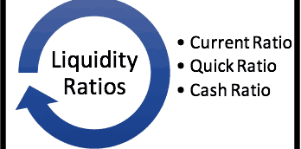

Slide 12
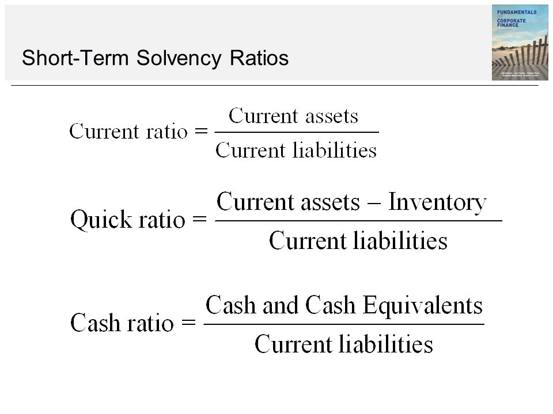

Slide 13
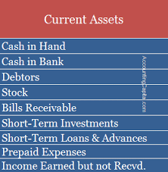
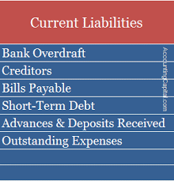
Current Assets & Current Liabilities

Slide 14


Slide 15
What is Leverage?
Financing the firm’s assets is a very crucial problem in every business and as a general rule there should be proper mix of debt and equity capital in financing the firm’s assets.
Leverage or Capital structure ratios are calculated to test the long-term financial position of a firm.
The use of long-term fixed interest-bearing debt and preference share capital along the equity share capital is called financial leverage or trading on equity.

Slide 16
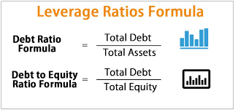

Slide 17
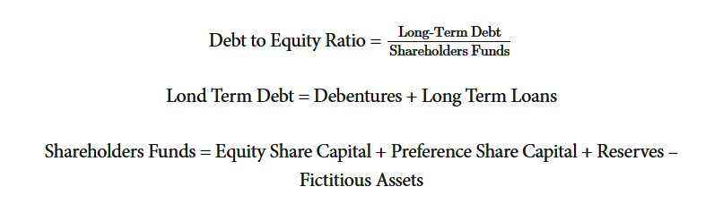

Slide 18
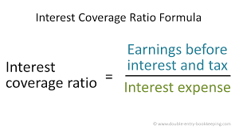

Slide 19


Slide 20
Activity Ratios – What they mean?
Activity ratios reflect how efficiently the company is managing its resources. These ratios express relationship between the level of sales and the investment in various assets, viz., inventories, receivables, fixed assets etc. The important turnover ratios are:
1. Inventory turnover Ratio 2. Debtors turnover Ratio
3. Fixed Assets turnover Ratio 4. Total Assets turnover Ratio
5. Working capital turnover Ratio

Slide 21
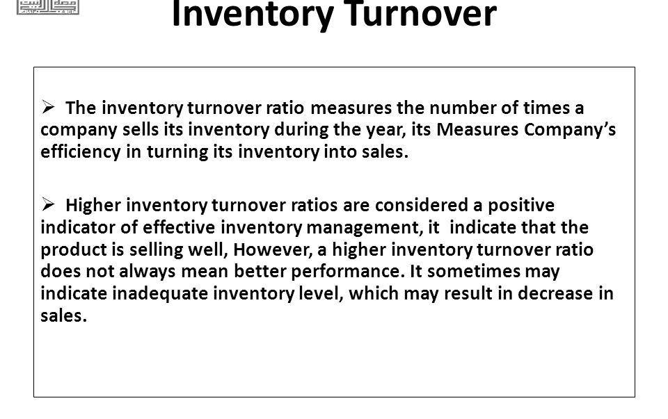

Slide 22
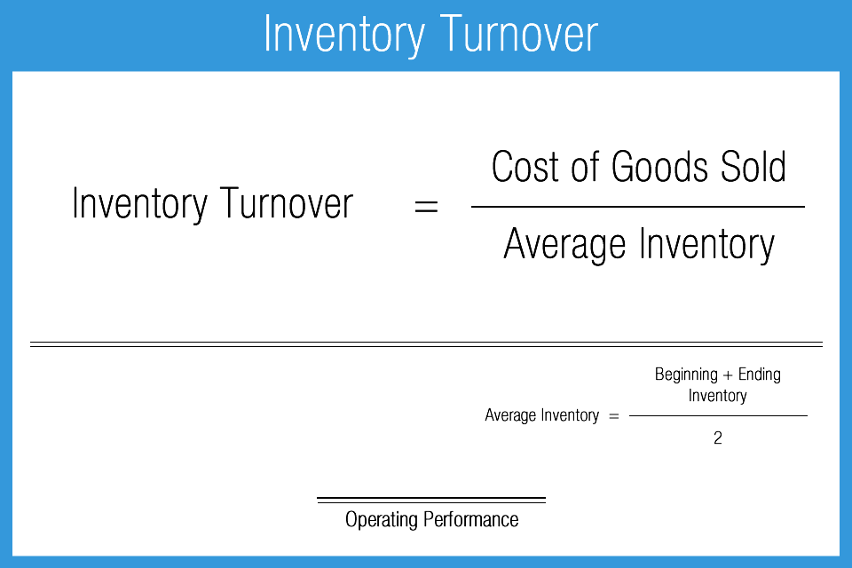

Slide 23
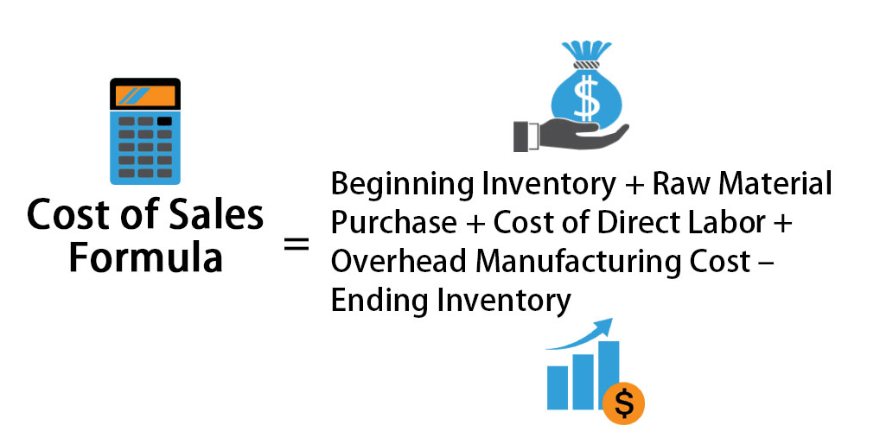

Slide 24
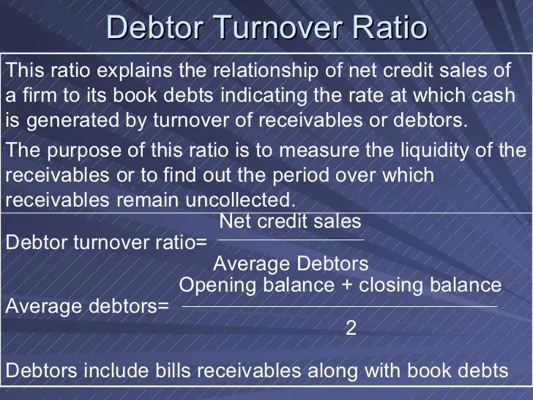

Slide 25

Average Collection Period

Slide 26
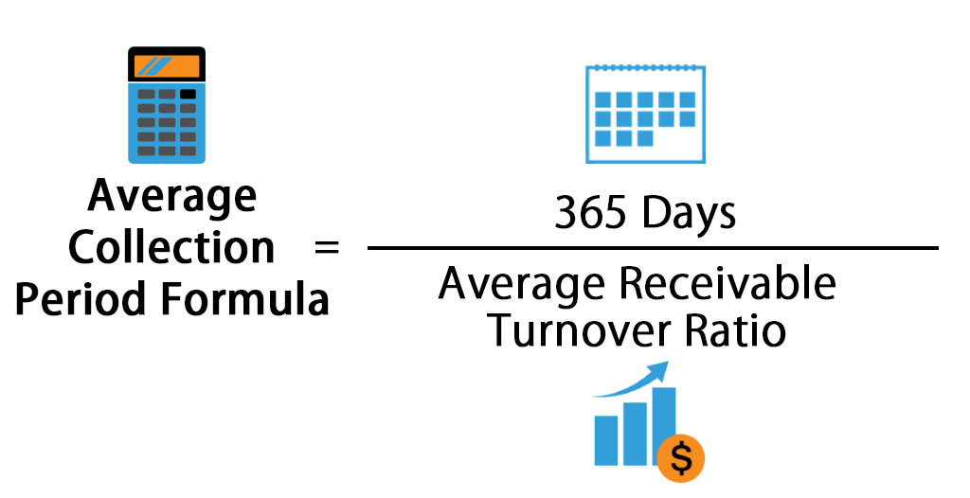

Slide 27
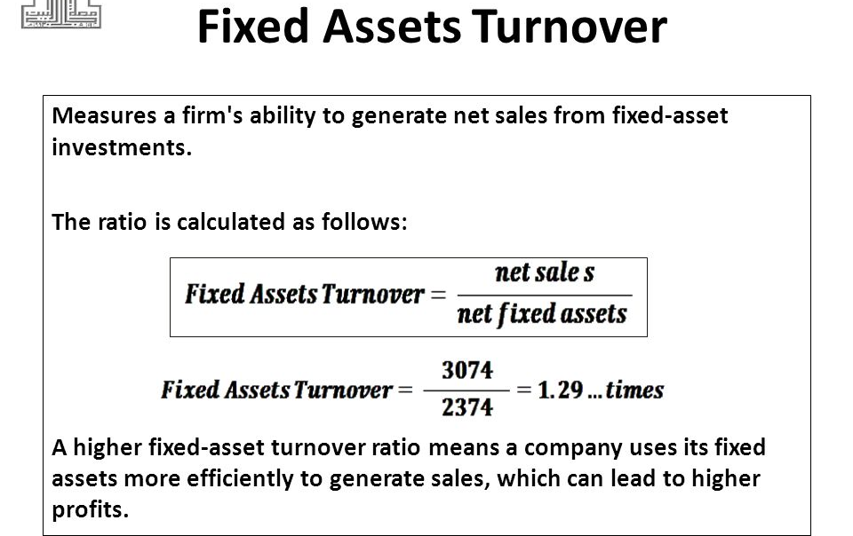

Slide 28
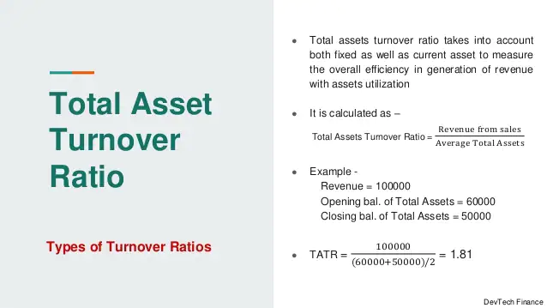

Slide 29
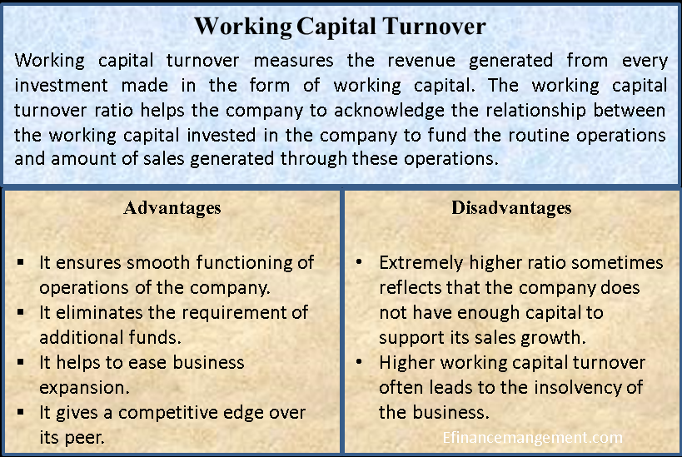

Slide 30
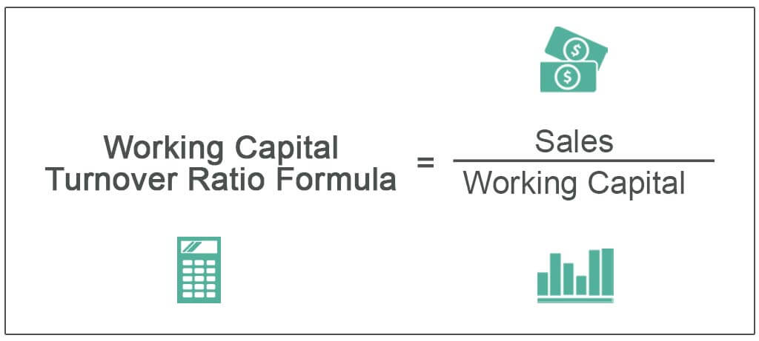

Slide 31
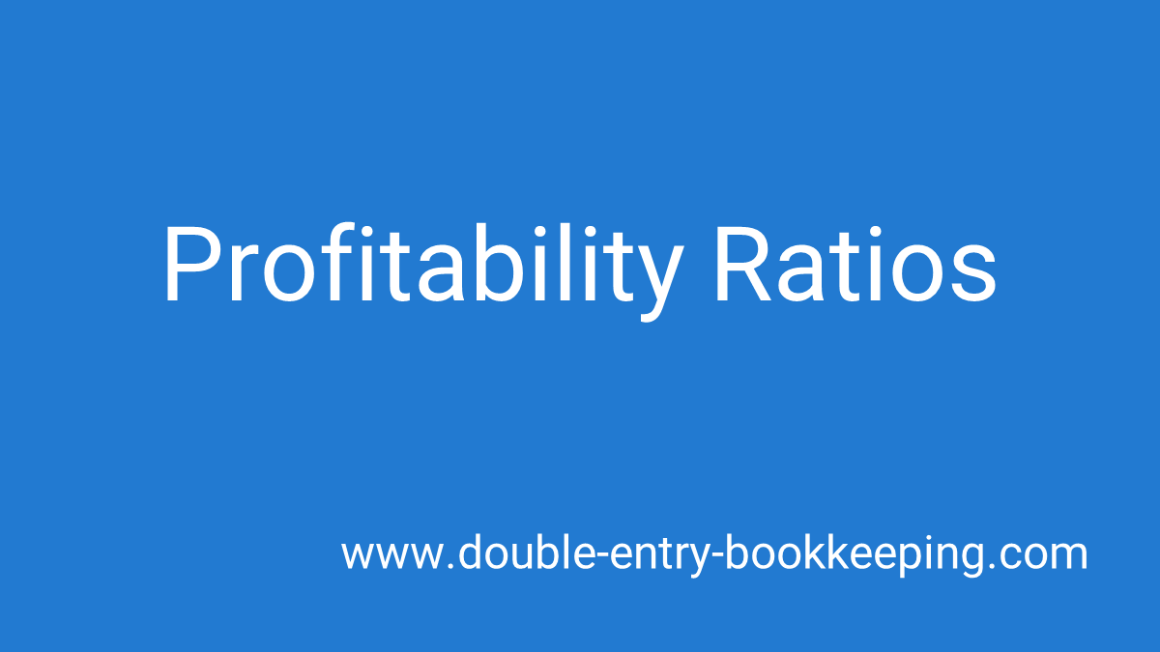

Slide 32
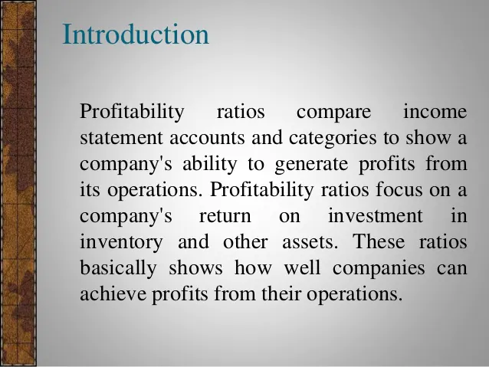

Slide 33
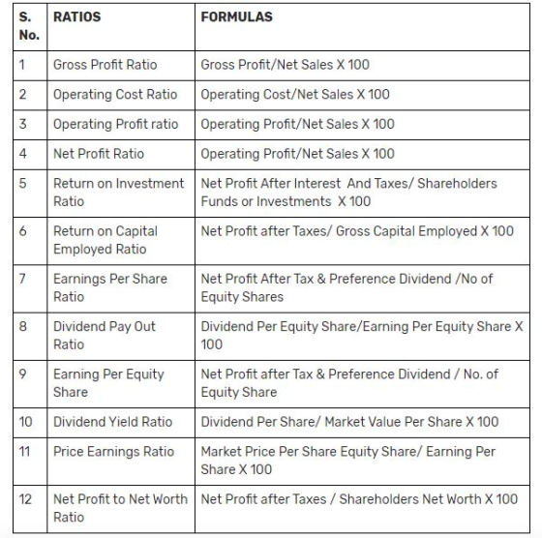

Slide 34
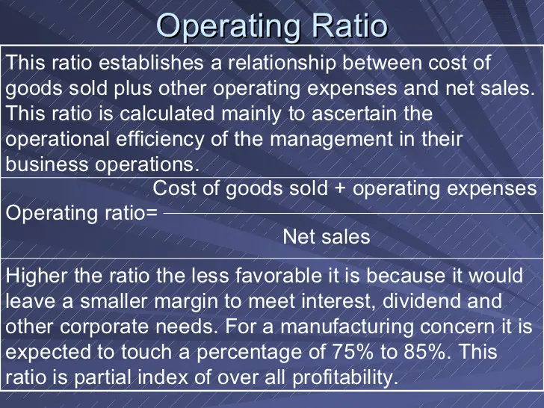

Slide 35
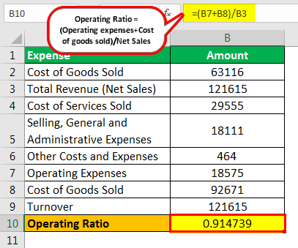

Slide 36
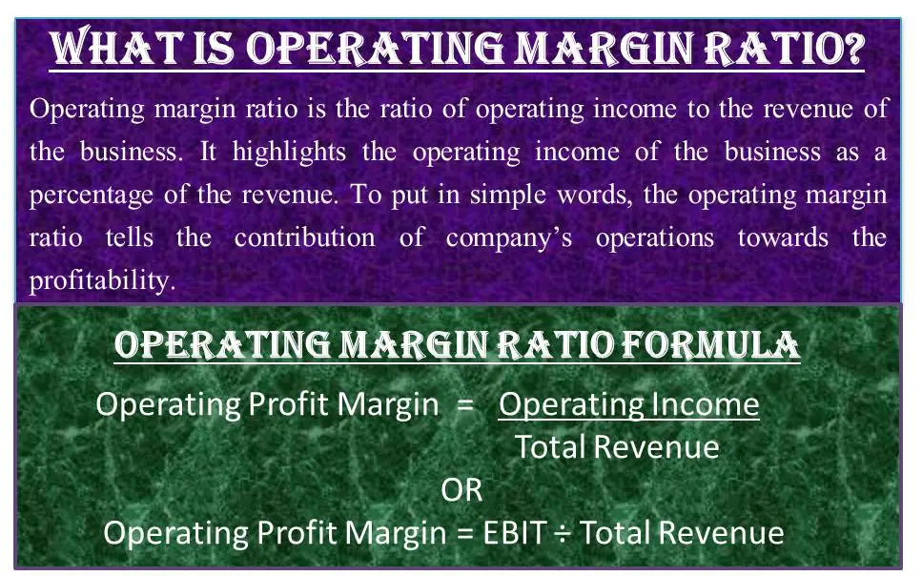

Slide 37
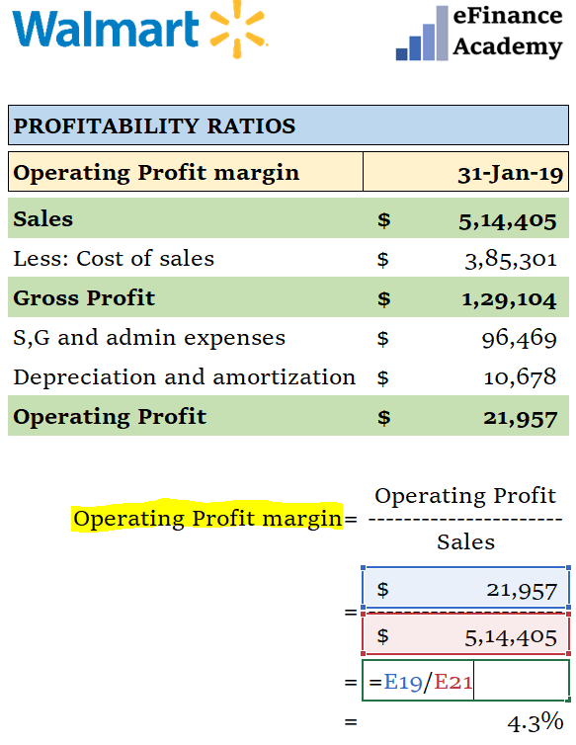

Slide 38
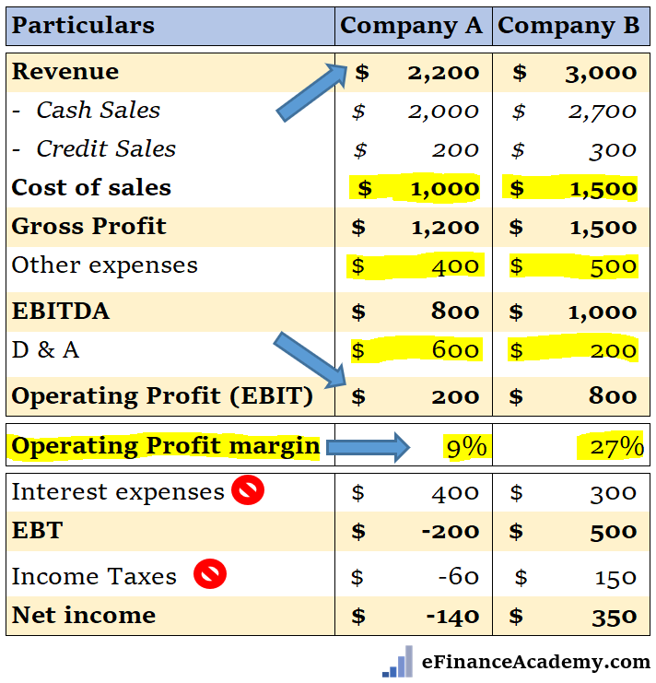

Slide 39
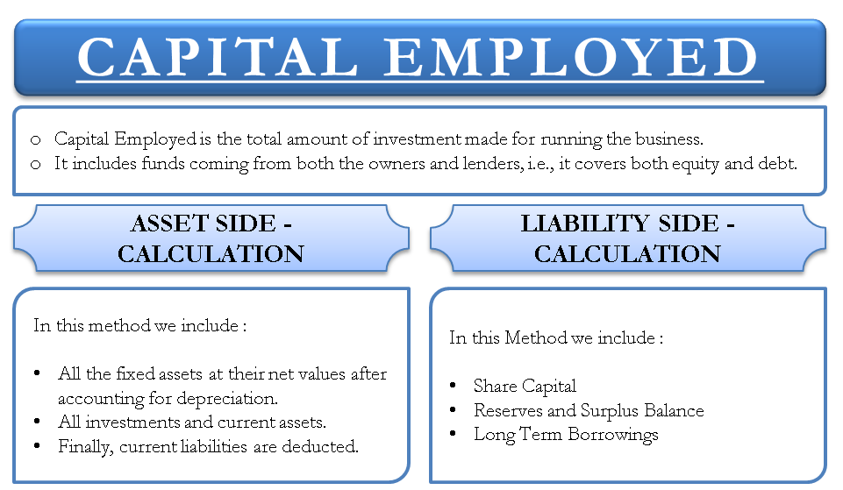

Slide 40
Following is the Trading, Profit & Loss a/c. of A Ltd for the year ending 31-03-2017
Particulars | Rs. | Particulars | Rs.
To Opening stock To Purchases To Wages To Factory overheads To Gross profit c/d To Administration expenses To Selling & distribution expenses: To Interest on debentures To Depreciation To Loss on sale of motor car To Net profit c/d | 5,00,000 11,00,000 3,00,000 2,00,000 5,00,000 ------------- 26,00,000 ------------- 75,000 50,000 20,000 60,000 5,000 3,20,000 ------------- 5,30,000 ====== | By Sales Cash 3,00,000 Credit 17,00,000 ------------ By Closing stock By Gross profit b/d By Dividends on investments By Profit on sale of furniture | 20,00,000 6,00,000 ------------- 26,00,000 -------------- 5,00,000 10,000 20,000 ------------- 5,30,000 =======
You are required to calculate: Gross profit ratio Net profit ratio Operating ratio Operating profit ratio.

Slide 41
The following information relates to Disco Electricals for the year ended 31st March, 2017
 | Rs.
Equity Share capital(80,000 shares @Rs.20 each) | 16,00,000
10% Preference Share capital @ Rs.20 each | 6,00,000
Profit after tax @ 10% | 5,40,000
Equity dividend paid @ 20%
Market Price per equity share | 80
Determine:
Dividend yield on equity shares
Earnings per share (EPS)
Price Earning Ratio (P/E ratio)

Slide 42
Calculate Current Ratio and Quick Ratio from following data-
Rs. Capital 10,00,000 Long-term loans 50,000 Creditors 30,000 Bills payable 30,000 Short-term loans 20,000 Outstanding exp 10,000 | Rs. Fixed Assets 10,00,000 Cash 50,000 Debtors 10,000 Inventories 50,000 Bills Receivable 10,000 Prepaid Expenses 20,000

Slide 43
The following is the information of two companies:
Particulars | V.Reddy Ltd (Rs.) | D.Reddy Ltd (Rs.)
Cash | 18,000 | 14,000
Debtors | 1,42,000 | 3,20,000
Inventory | 1,80,000 | 5,40,000
Bills payable | 27,000 | 10,000
Creditors | 50,000 | 40,000
Accrued expenses | 15,000 | 12,500
Tax payable | 75,000 | 10,000
Calculate the liquidity ratios and comment.

Slide 44
The following from the financial statements of Blue and Red Ltd as on 31-3- 2015
Particulars | 31-3-2013(Rs.) | 31-3-2014(Rs.
Stock | 10,000 | 25,000
Debtors | 20,000 | 20,000
Bills receivable | 10,000 | 5,000
Cash in hand | 18,000 | 15,000
Bills payable | 15,000 | 20,000
Bank Overdraft | - | 2,000
9% Debentures | 5,00,000 | 5,00,00
Sales for the year | 3,50,000 | 3,00,00
Gross profit | 70,000 | 50,000
Calculate the liquidity ratios and Stock turnover ratio and comment on the results

Slide 45
From the following information calculate:
a)Stock Turnover ratio b)Debtors Turnover ratio
 | Rs.
Cost of goods sold | 80,000
Sales | 3,20,000
Opening stock | 29,000
Closing stock | 31,000
Opening debtors | 30,000
Closing debtors | 20,000

Slide 46
The Balance sheet of X & Co as on 31-3-2014 shows as follows:
Liabilities | Rs. | Assets | Rs.
Equity capital | 1,00,000 | Fixed assets | 1,80,000
9% Preference shares | 50,000 | Stores | 25,000
8% Debentures | 50,000 | Debtors | 55,000
Retained Earnings | 20,000 | Bills receivables | 3,000
Creditors | 45,000 | Bank | 2,000
 | 2,65,000 |  | 2,65,000
Compute Debt - Equity ratio, Current ratio and Liquidity ration and comment on financial position of the company

Slide 47
